Slide 1

Historically Underutilize Business (HUB)
HUB Subcontracting Plan (HSP) Overview and Training

Slide 2
Agenda
  HSP Overview
  HSP Quick Checklist
  Types of Methods to Achieving HUB Compliance
      Method 1: All HUBs
      Method 2: Meet the Goal
      Method 3: Good Faith Effort
      Method 4: Self-Performing
  CPA’s Commodity Book
  CMBL Searching
  Post-Award & Progress Assessment Report (PARs)
    Method I: All HUBs

Slide 3
HSP OVERVIEW
(TGC §2161 and 34 TAC §20.285)
Required on solicitation over $100k
HUB Subcontracting Goal is indicated in the solicitation form and the assigned HUB subcontracting goal as per the 2009 Texas Disparity Study:
      Procurement Category
      11.2%: Heavy Construction
      21.1%: Building Construction
      32.9%: Special Trade Construction
      23.7%: Professional Services
      26.0%: Other Services
      21.1%: Commodities

Slide 4
HSP OVERVIEW
(TGC §2161 and 34 TAC §20.285)
HUB = Historically Underutilized Business
    A small business, by SBA standards
    51%+ owned & operated by a member of the following groups:
    Asian Pacific American, Black American, Hispanic American, Native American, American Woman, and and/or 20%+ Service-Disabled Veterans
    Reside and primary place of business must be in Texas.
    Active in the business daily control.
CMBL= CMBL (Centralized Master Bidders List) & HUB Directory = TX Certified HUBs
HSP = HUB Subcontracting Plan
GFE = Good Faith Effort

Slide 5
HSP OVERVIEW
(TGC §2161 and 34 TAC §20.285)
Subcontractor= Government Code, §2251.001:
    Contracts with a prime contractor towards
        •completing work
        •providing materials
        •supplies, equipment and/or services for a governmental entity.
Includes Non-W2 employee, 1099, or even teaming partners

Slide 6
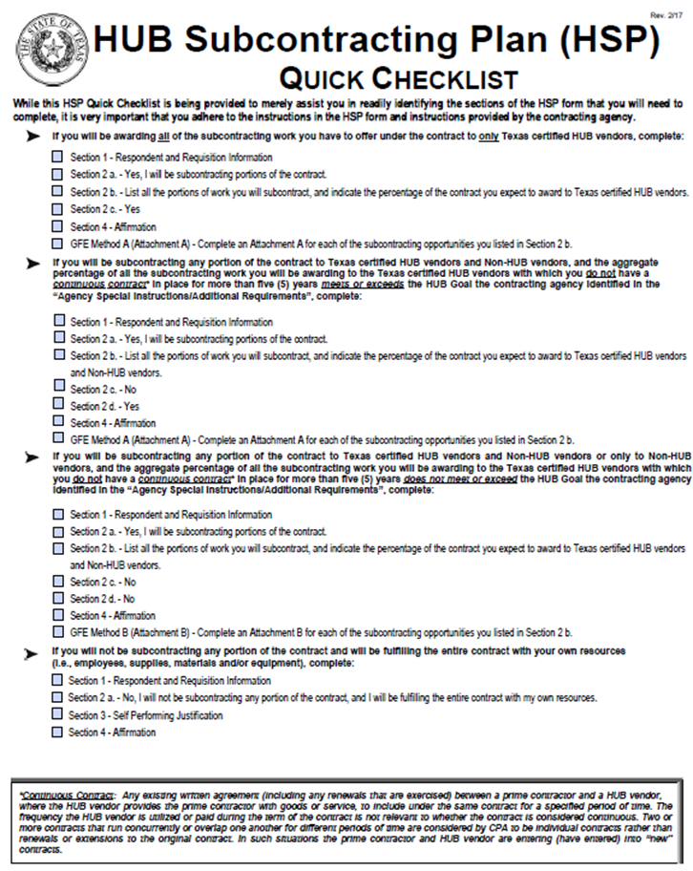
HSP Quick Checklist
This document was created by the Texas Comptroller of Public Accounts as a guide to complete the HSP.
There are 4 Methods to Achieving HUB Compliance.

Slide 7
Types of Methods to Achieving HUB Compliance
Method 1: All HUBs

Slide 8
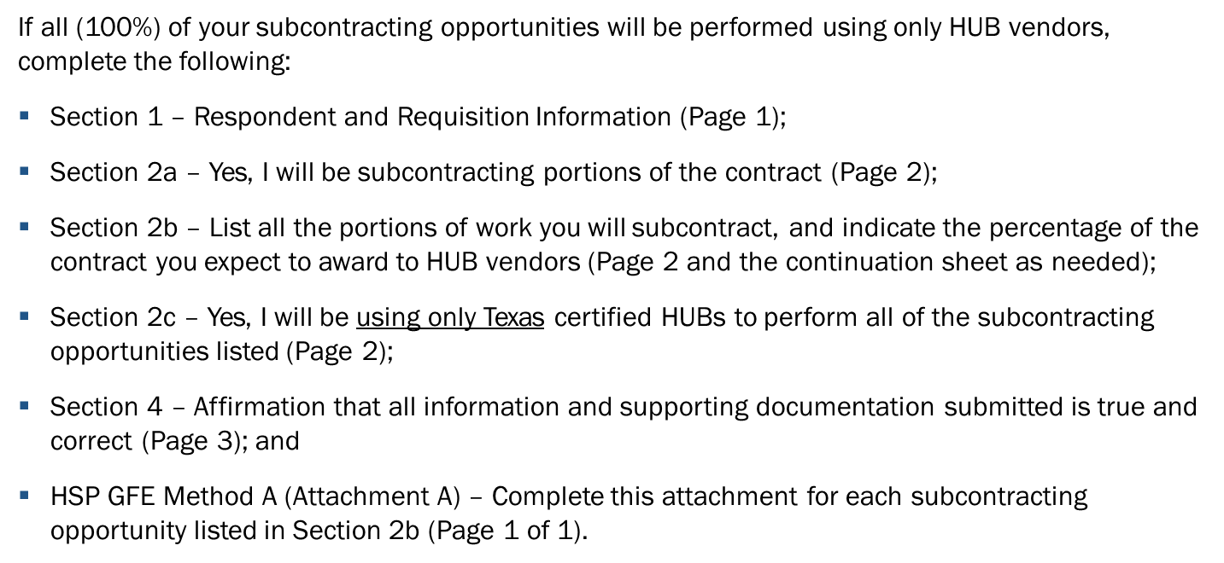
Method 1: All HUBs

Slide 9
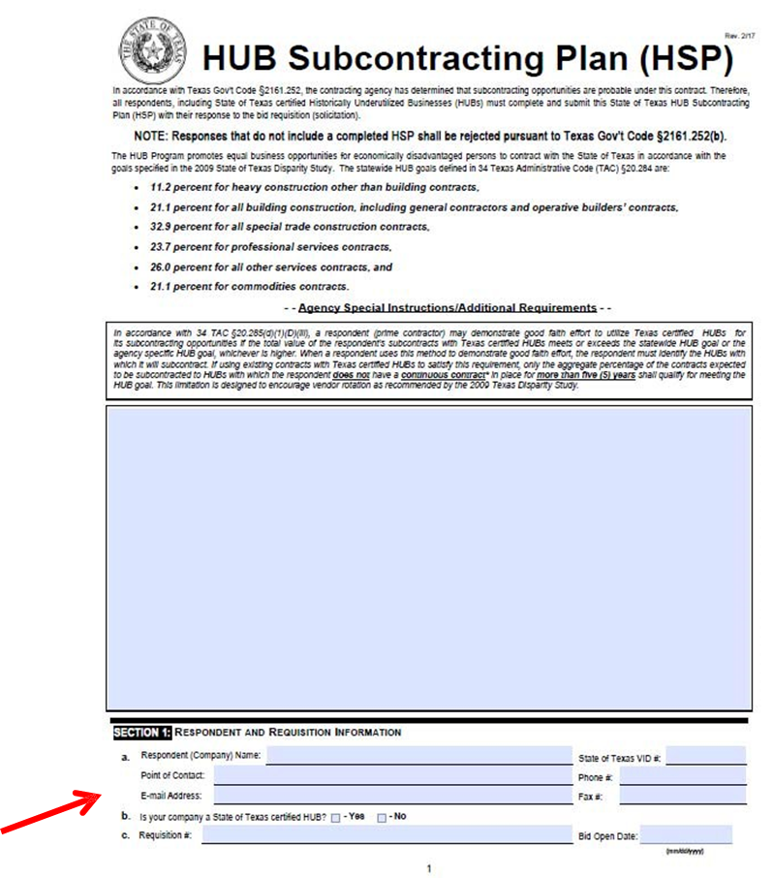

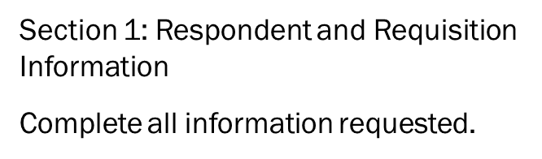
Method 1: All HUBs

Slide 10
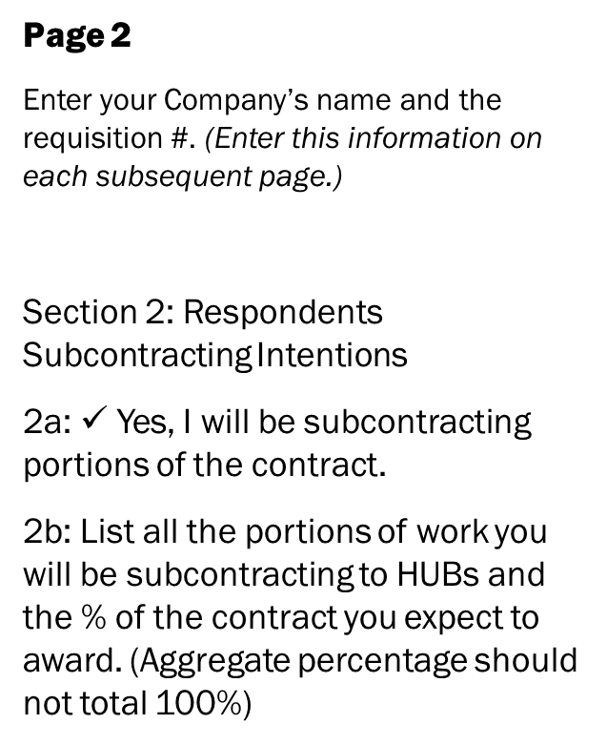
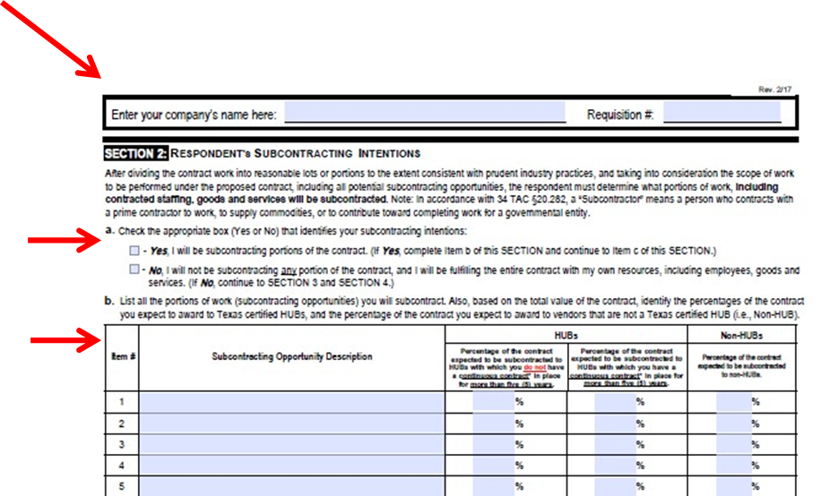
Method 1: All HUBs

Slide 11
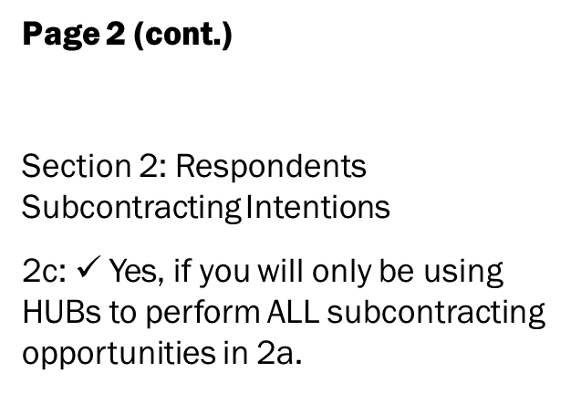
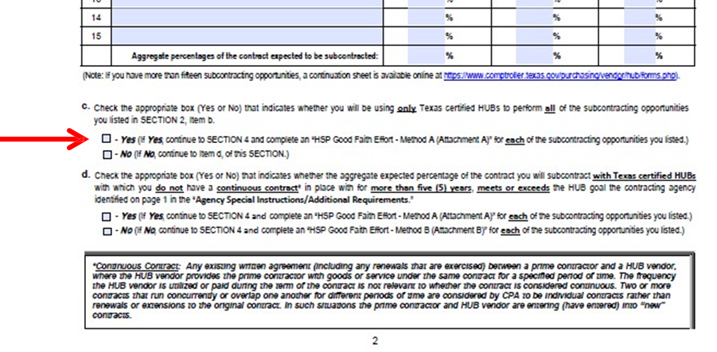

Method 1: All HUBs

Slide 12
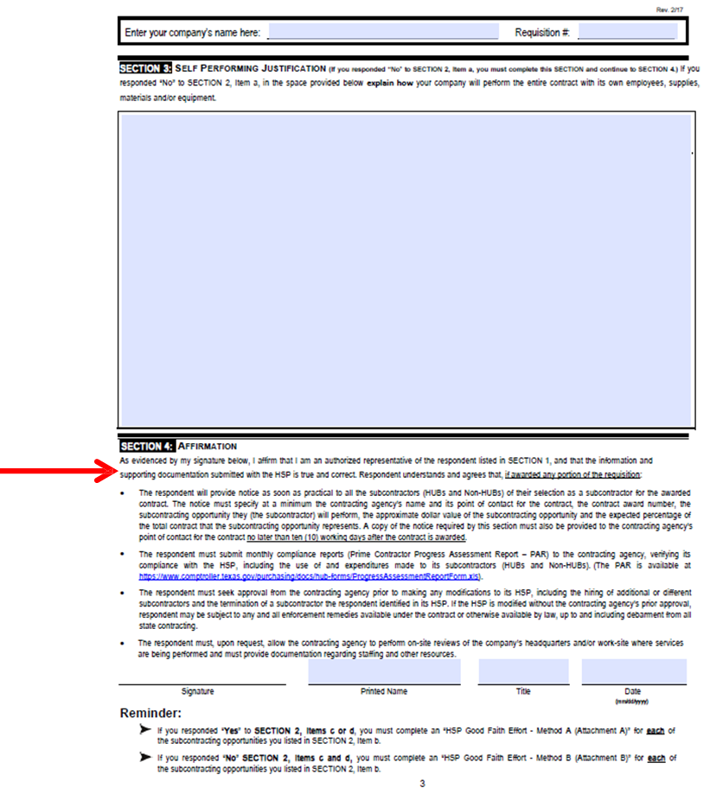

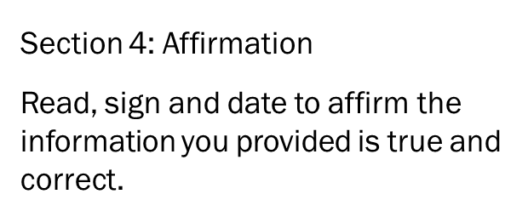
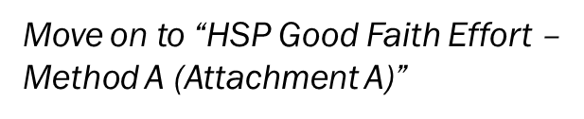
Method 1: All HUBs

Slide 13
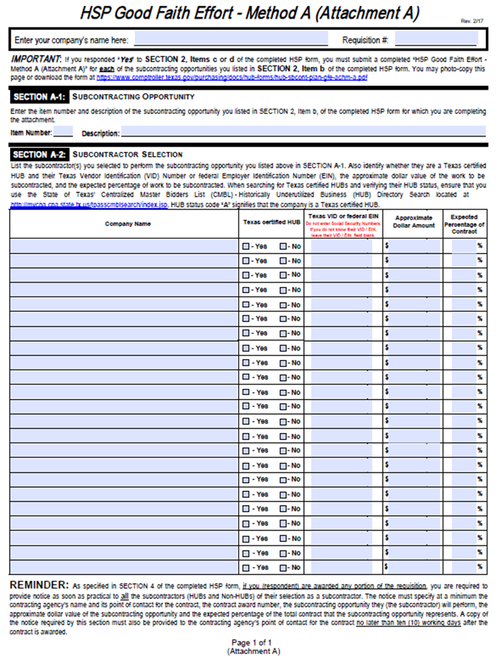
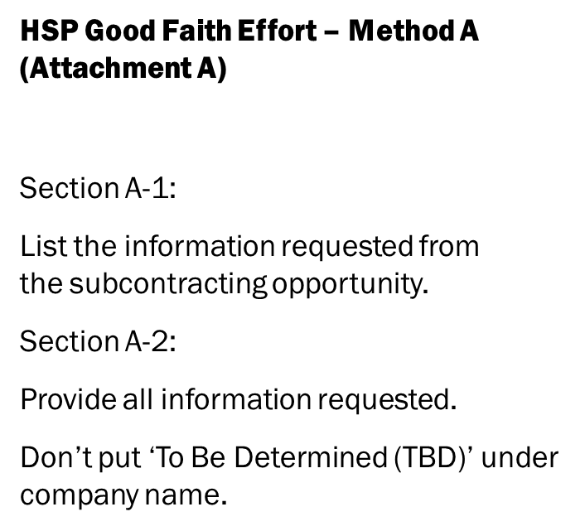

Method 1: All HUBs

Slide 14
Types of Methods to Achieving HUB Compliance
Method 2: Meet the Goal
HUB Goal is listed in the solicitation

Slide 15
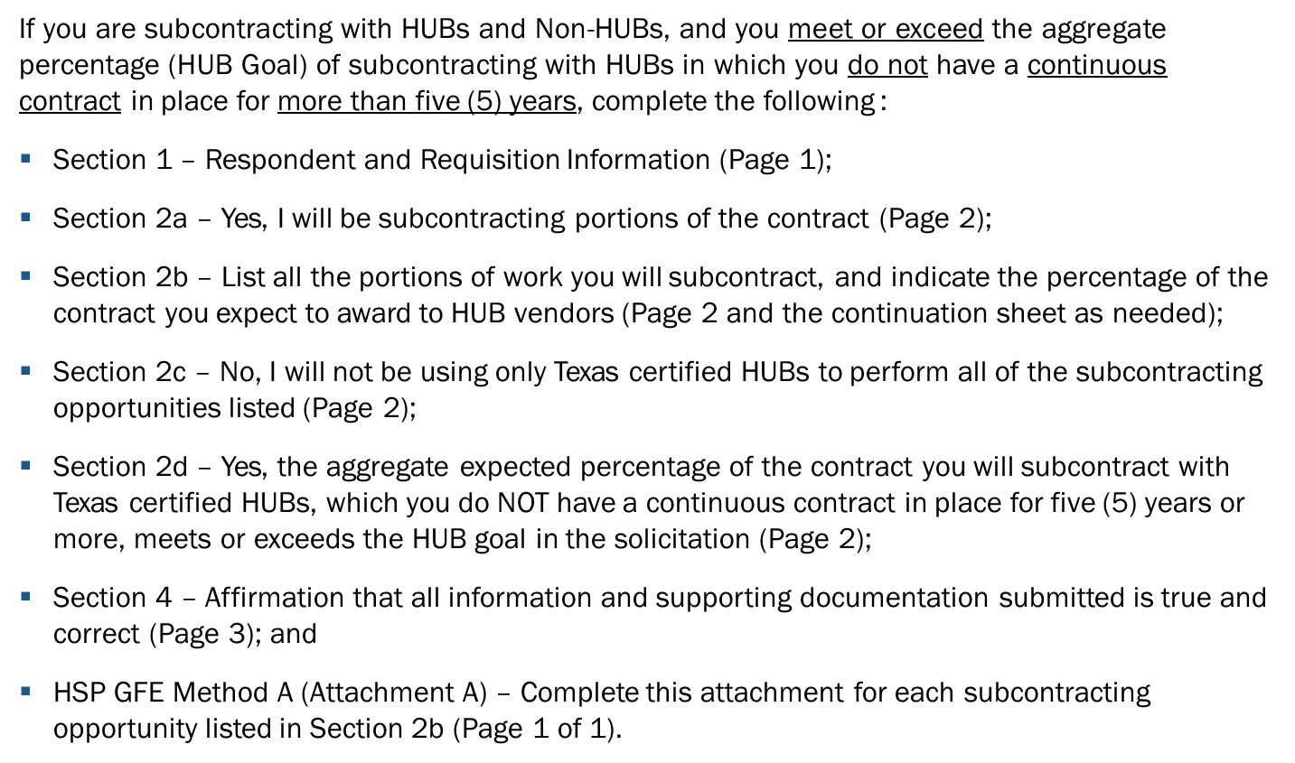
Method 2: Meet the Goal

Slide 16
Method 2: Meet the Goal

Slide 17
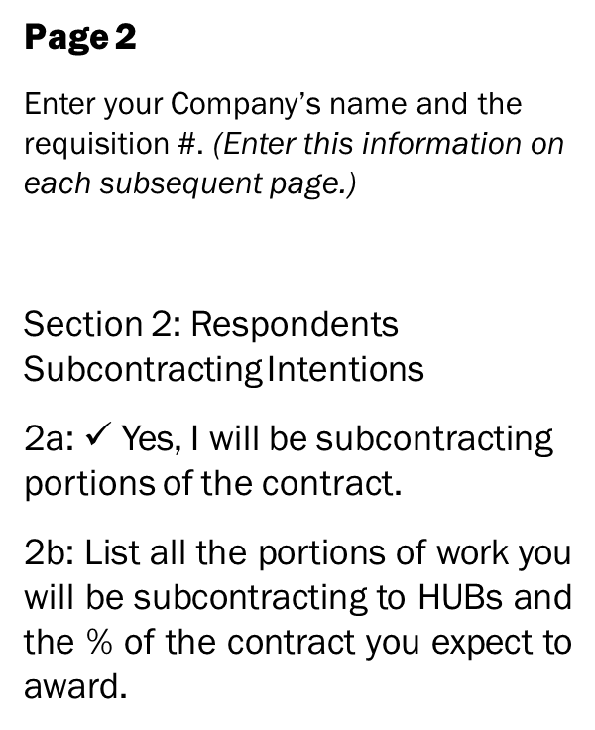
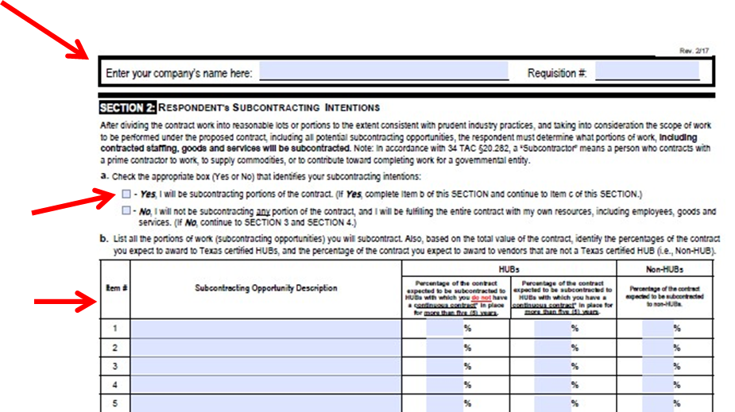

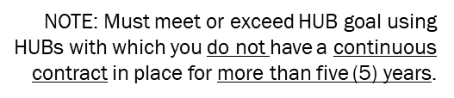
Method 2: Meet the Goal

Slide 18
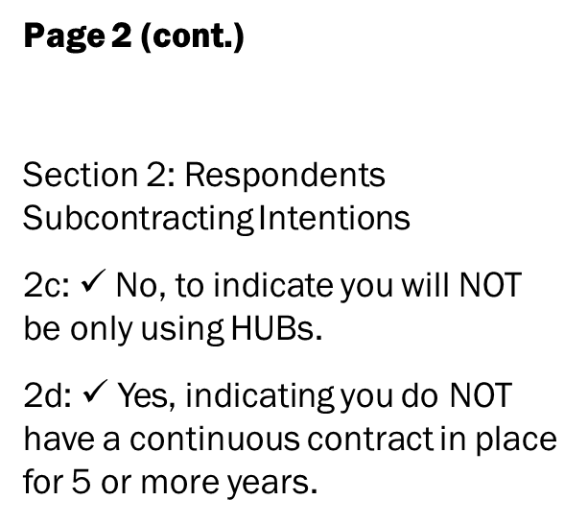
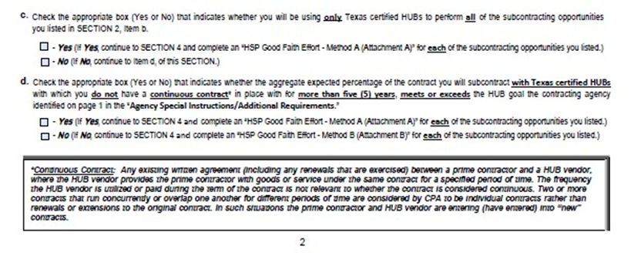

Method 2: Meet the Goal

Slide 19

Method 2: Meet the Goal

Slide 20
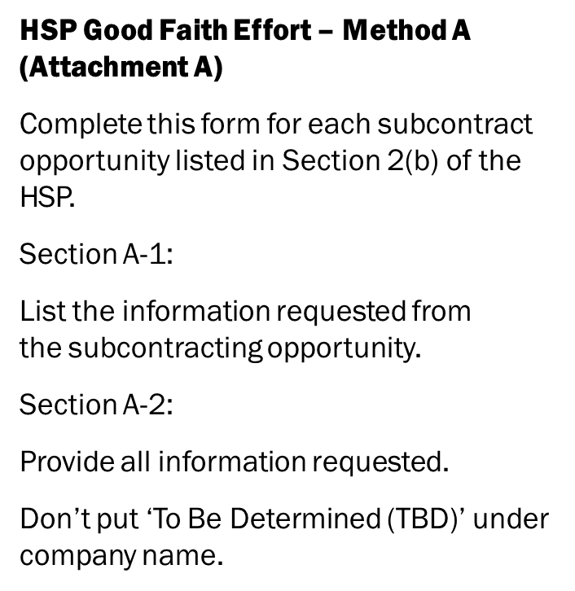
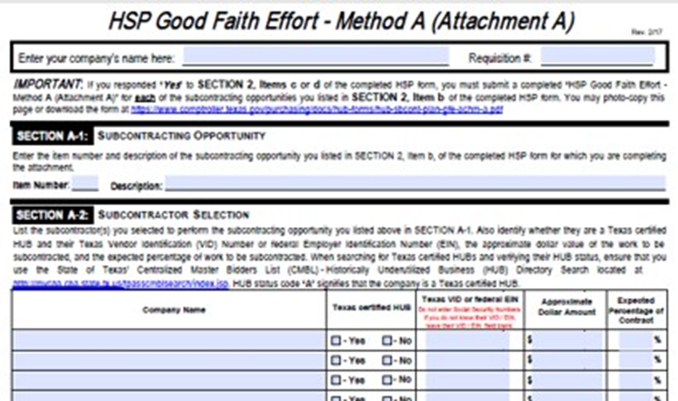
Method 2: Meet the Goal

Slide 21
Method 2: Meet the Goal

Slide 22
Types of Methods to Achieving HUB Compliance
Method 3: Good Faith Effort

Slide 23
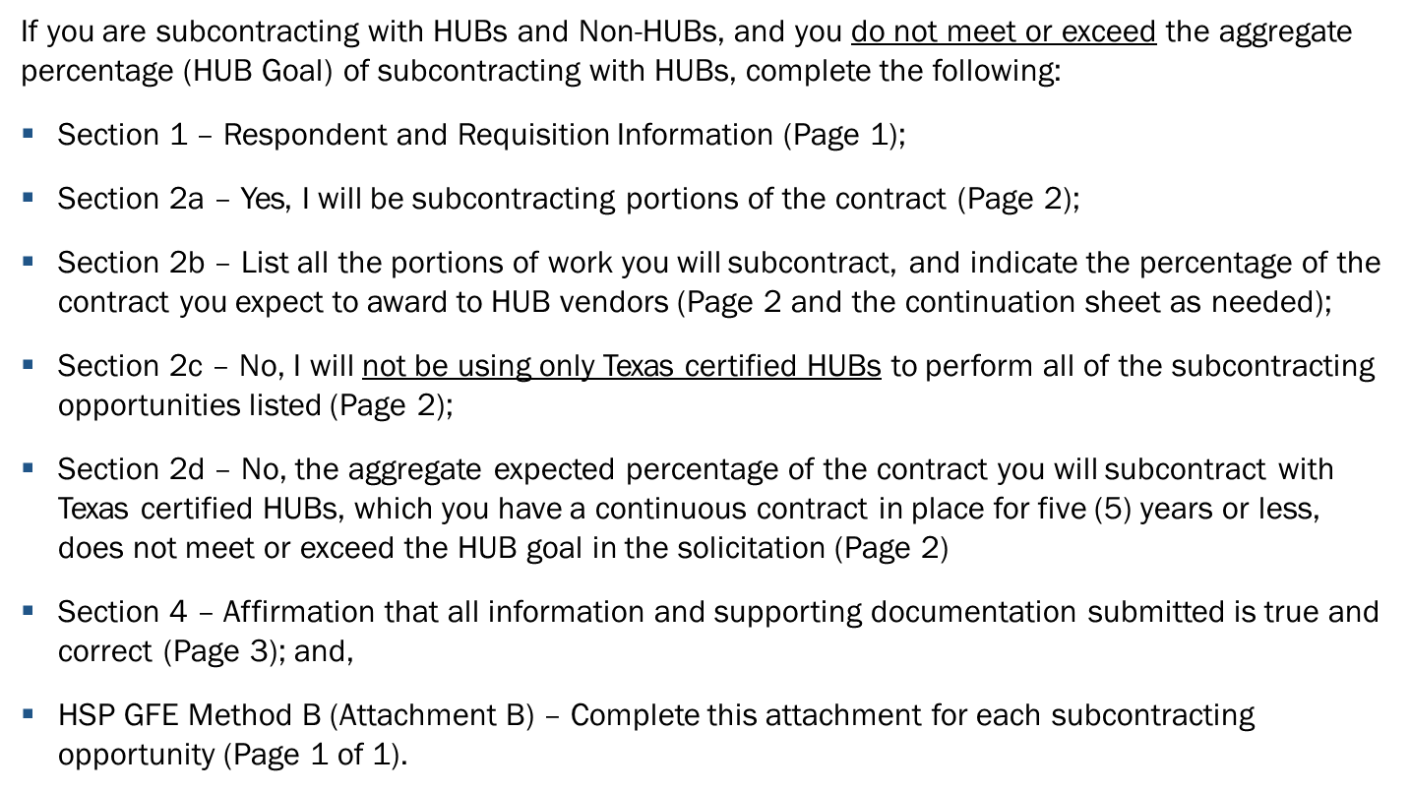
Method 3: Good Faith Effort

Slide 24
Method 3: Good Faith Effort

Slide 25

Method 3: Good Faith Effort

Slide 26
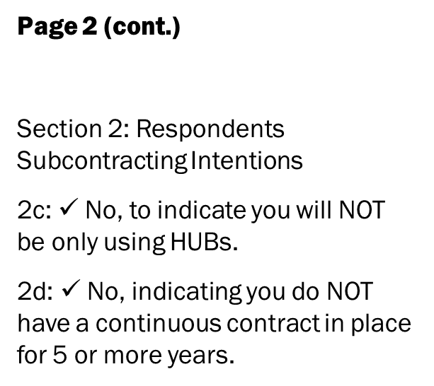
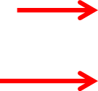
Method 3: Good Faith Effort

Slide 27
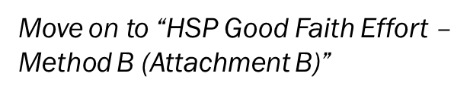
Method 3: Good Faith Effort

Slide 28
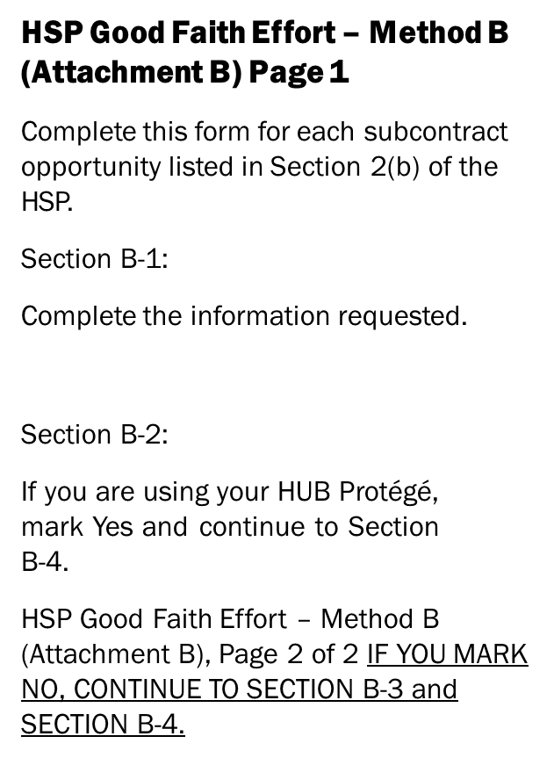
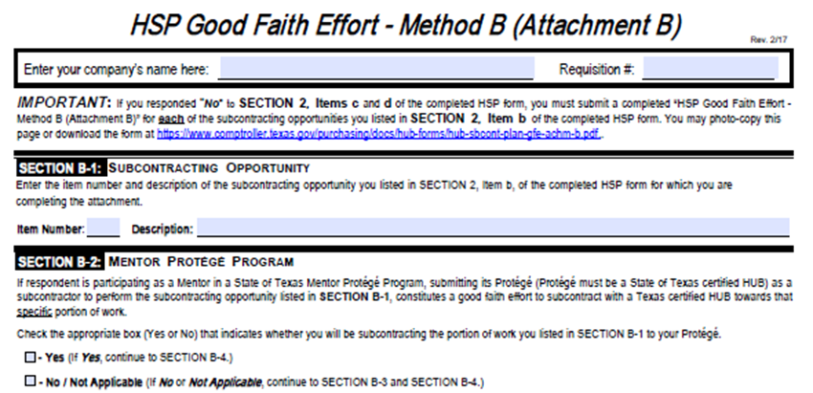


Method 3: Good Faith Effort

Slide 29
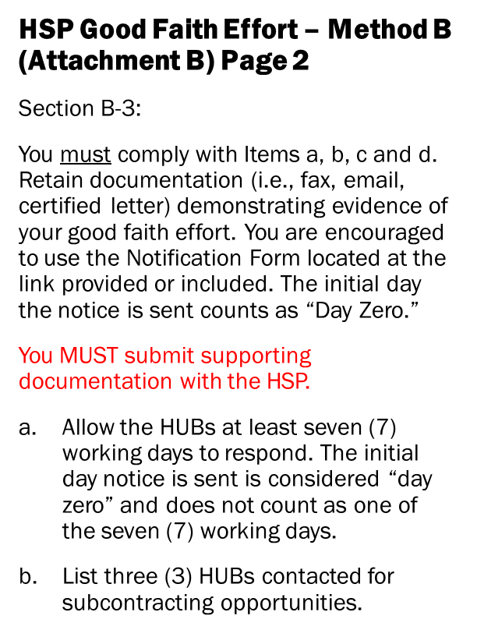
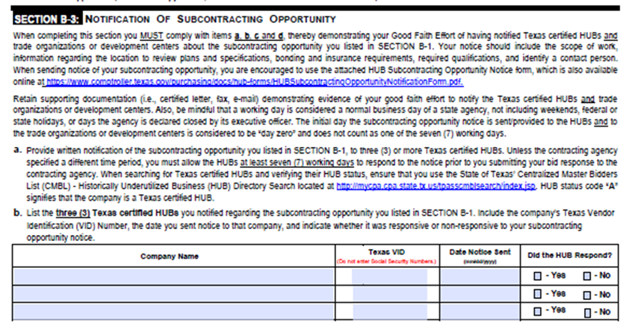
Method 3: Good Faith Effort

Slide 30
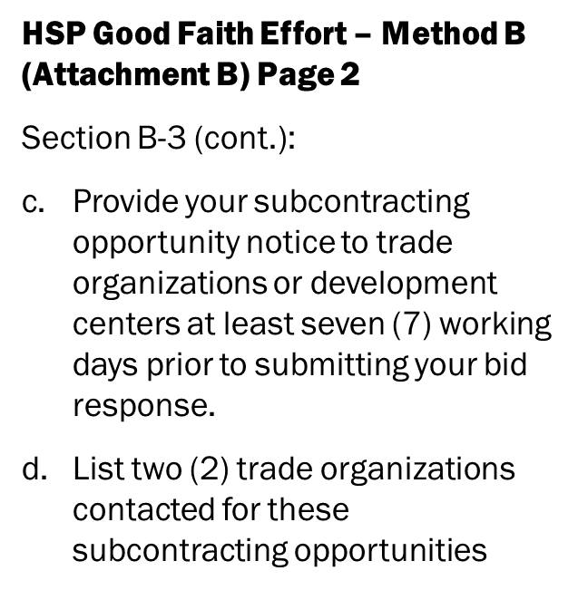

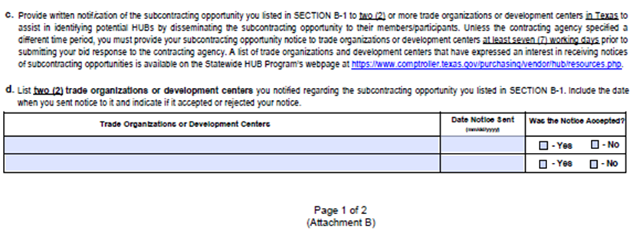
Method 3: Good Faith Effort

Slide 31
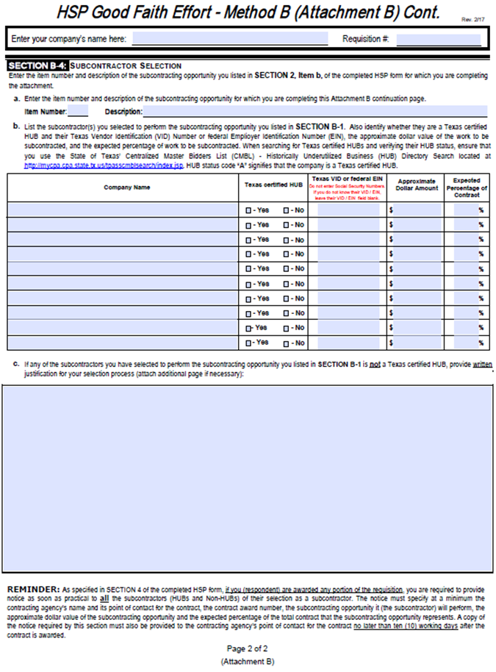
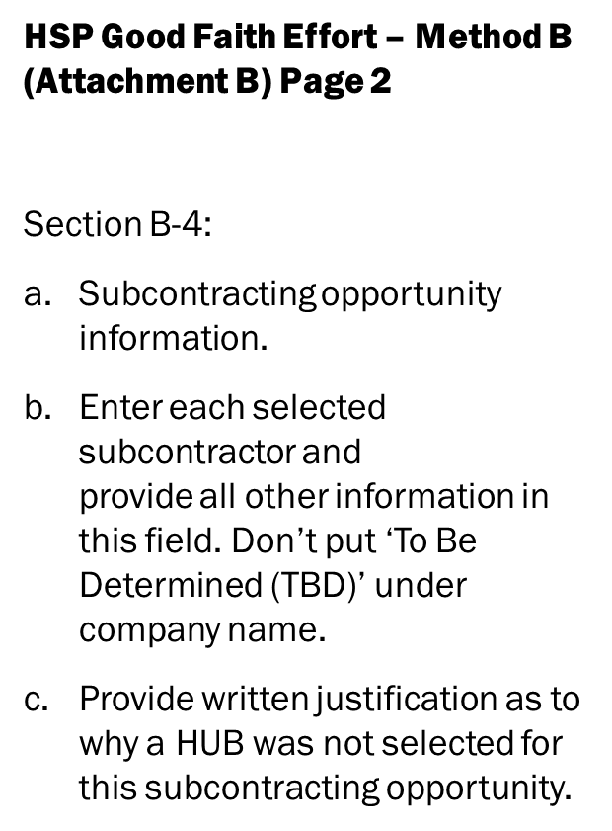



Method 3: Good Faith Effort

Slide 32
Types of Methods to Achieving HUB Compliance
Method 4: Self-Performing

Slide 33
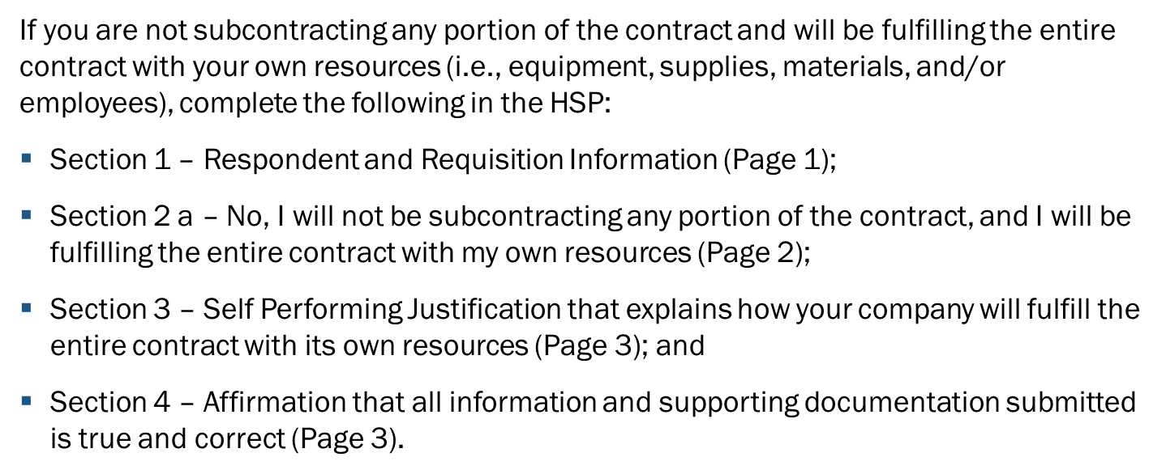
Method 4: Self-Performing

Slide 34
Method 4: Self-Performing

Slide 35
Method 4: Self-Performing

Slide 36
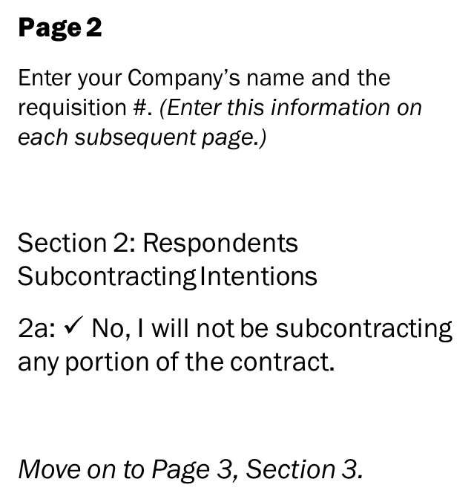
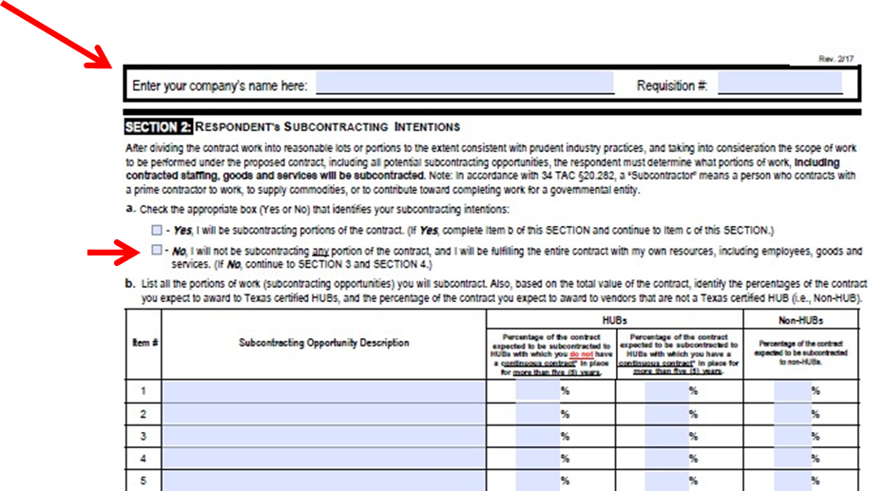
Method 4: Self-Performing

Slide 37
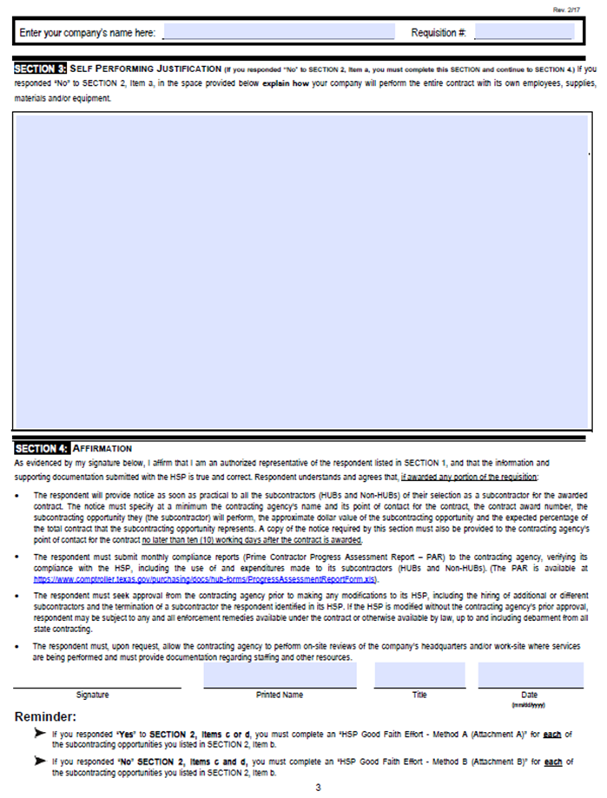
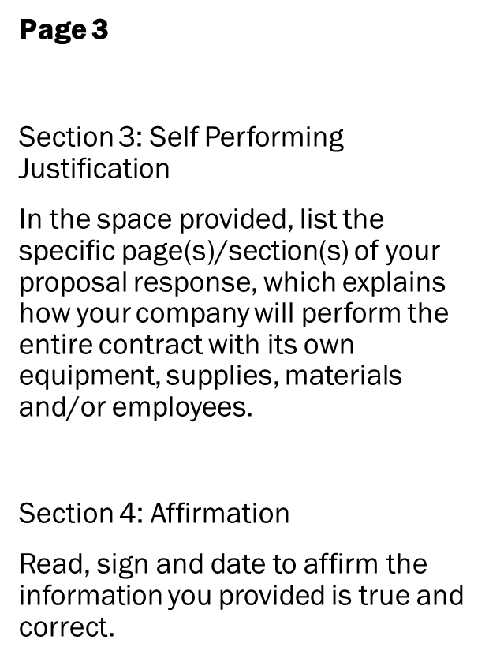

Method 4: Self-Performing

Slide 38
  CPA’s Commodity Book
https://mycpa.cpa.state.tx.us/commbook/

Slide 39
  CMBL Searching
https://mycpa.cpa.state.tx.us/tpasscmblsearch/tpasscmblsearch.do

Slide 40
  PARs (Progress Assessment Reports)
Required Monthly with All Pay Request.
Must be Signed
Must match the Invoice amount
List All Subcontractors payments (HUBs and Non-HUBs).
Required even if Self-Performing all the work.

Slide 41
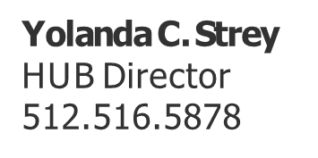
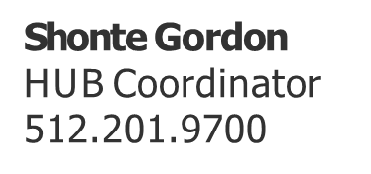
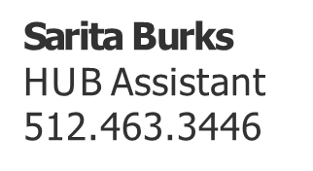
Questions?
Contact Us: HUB@tfc.state.tx.us

